Slide 1
Science for Life Laboratory
Elina Staaf
Project Coordinator

Slide 2
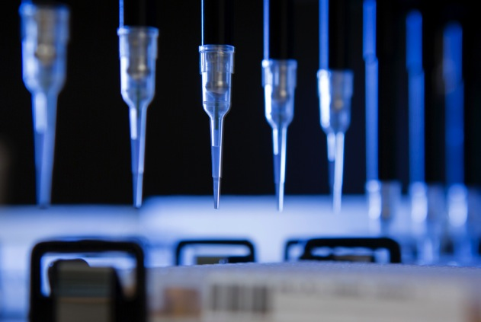
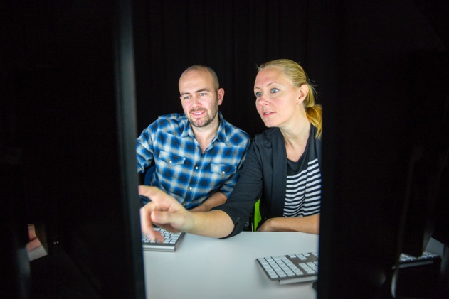

4 host universities
Established in 2010
National resource since 2013
More than 1000 researchers

Slide 3
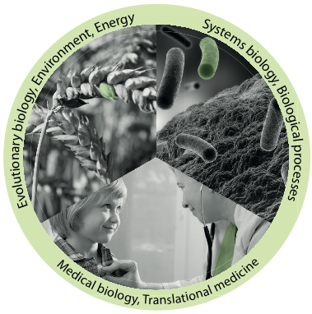
Vision
To be an internationally leading center that develops, uses and provides access to advanced technologies for molecular biosciences with focus on health and environment

Slide 4

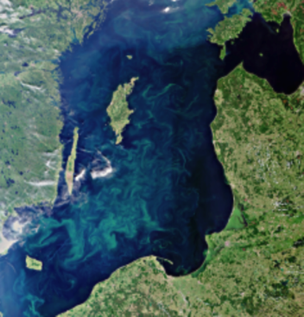
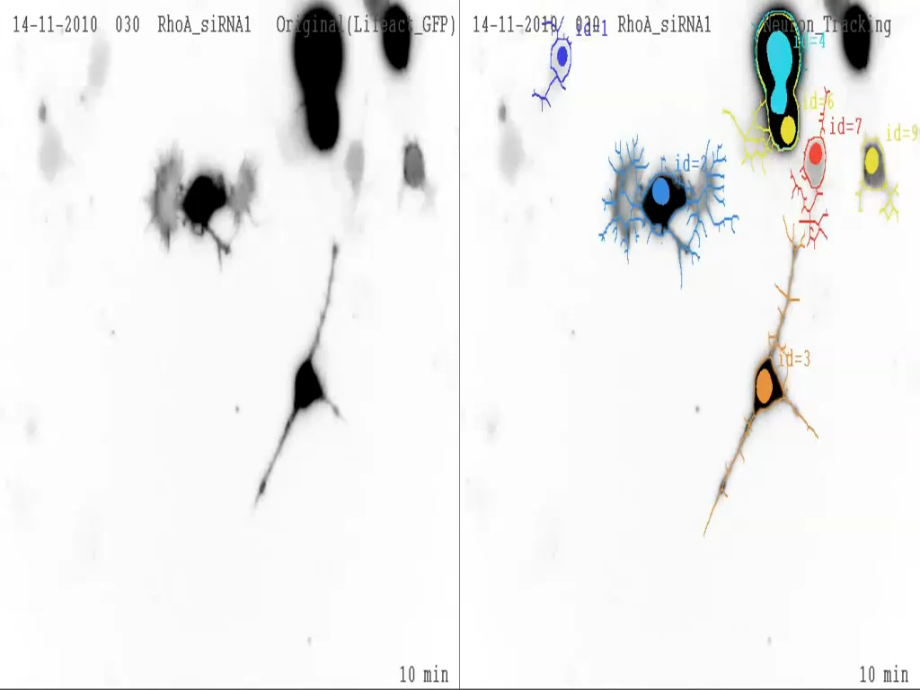
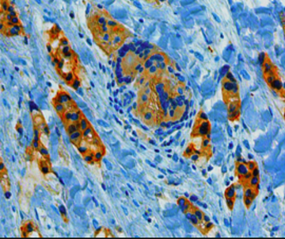
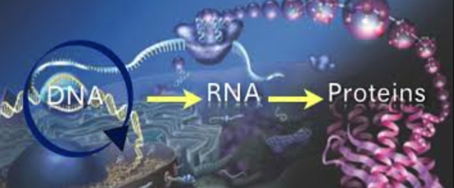
The range of life sciences studied
Ecosystems
Communities
Populations
Organisms
Organs
Tissues
Cells
Organelles
Molecules

Slide 5
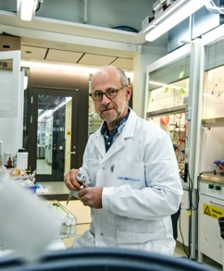
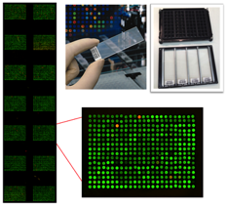
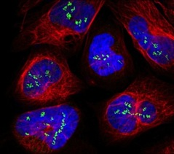
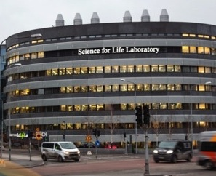
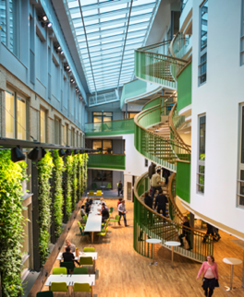
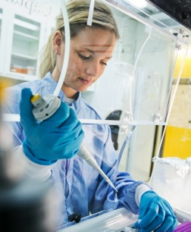
Mission
Technology platforms for national use
Service to research community
Technology development
Education
Strong research community
Strong interdisciplinary community
SciLifeLab Fellows Program
National projects
Society impact
Health care outcome
Environment
Tech transfer, spin-offs, industry collaborations
Notes:
Our mission and what we do is :
To provide service to researchers
to be on the cutting edge we do technology development within the platforms
also we educate the community by hosting methodology courses, workshops etc

Slide 6
Available technique areas
Drug Discovery & Development
Biomaterials
Chemical Biology
Mass Spectrometry
Proteomics
Bioimaging
Structural Biology
Bioinformatics
Genomics
Clinical Diagnostics
Functional genomics
Metabolomics
Zebrafish Model System

Slide 7
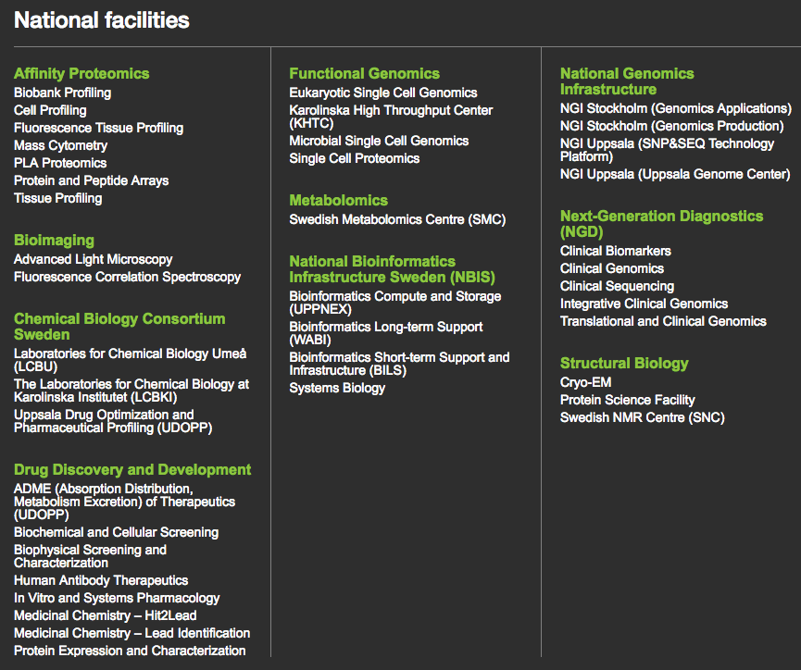
Platforms and facilities

Slide 8
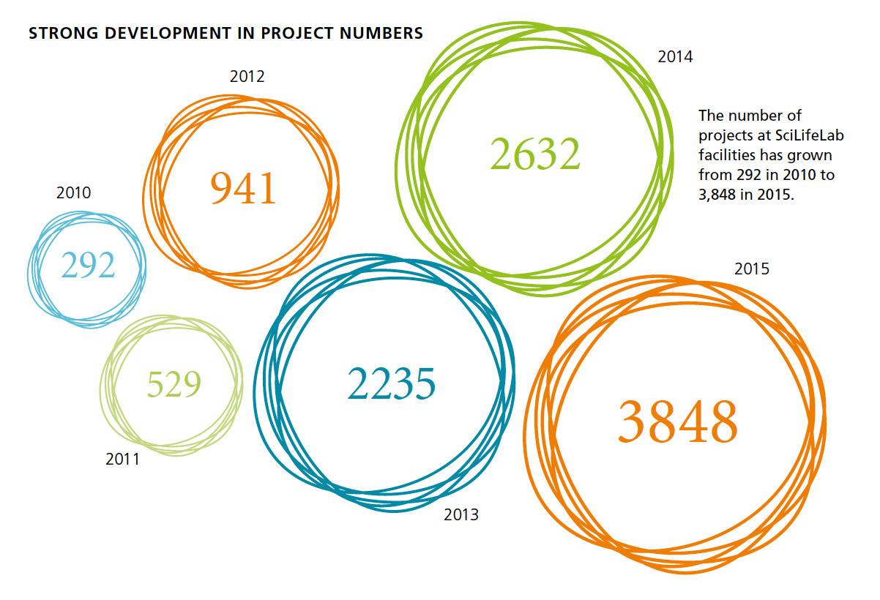
Annual report 2015: Service projects
Notes:
We have had a steady increase since 2010 in the amount of research projects that our platforms have been served.
The first year 292 projects where served and up to 3848 projects last year!

Slide 9
Upcoming courses
Date | Course
January 23-27 | Introduction to Bioinformatics using NGS data
February 6-10 | Python programming with applications to Bioinformatics
March 25-27 | RNA-seq
March 27-31 | R Programming Foundations for Life Scientists
May 9-11 | Introduction to Genome Annotation
May 15-19 | Introduction to Bioinformatics using NGS data, Göteborg
Application Nov/Dec | The Swedish Bioinformatics Advisory Program

Slide 10

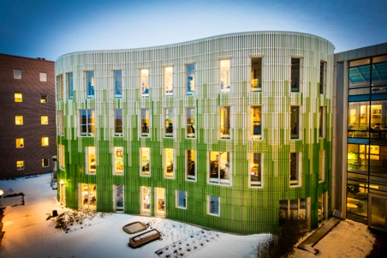
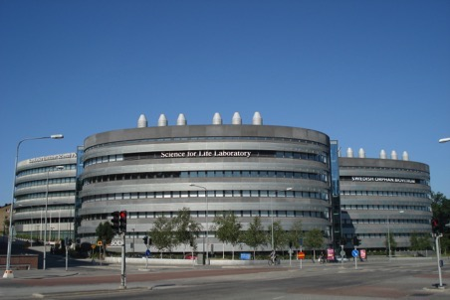
Nodes and sites
Uppsala node
Umeå
Stockholm node (Solna)
Linköping
Göteborg
Lund
Notes:
SciLifeLab comprises technologies and competence at several Swedish Universities outside Stockholm and Uppsala:
Linköping University
Gothenburg University and Chalmers
Lund University
Umeå University
Swedish University of Agricultural Sciences Umeå

Slide 11
Platforms and facilities

Slide 12
Mission
Technology platforms for national use
Service to research community
Technology development
Education
Strong research community
Strong interdisciplinary community
SciLifeLab Fellows Program
National projects
Society impact
Health care outcome
Environment
Tech transfer, spin-offs, industry collaborations
Notes:
We aim to have a strong research community. Often characterized by:
high citation index publications, Good examination ratio of phd students, invitations to speak at international symposia and attract many post-docs and guest researchers that contributes to new perspectives, openess and curiosity. Also strong principal investigators unite a strong research commuity
16 young talented researchers funded by SciLifeLab (fellows)

Slide 13

Fellows program
What?
Regular recruitment of young, talented research leaders
Why?
To further strengthen the research environment
How?
Each fellow is recruited by a Swedish university and receives funding from them
When?
First call opened in 2013 with fellows employed by KI, KTH, SU and UU. In 2016 the program was broadened to include fellows employed by other universities than the host universities.
Notes:
16 young talented researchers funded by SciLifeLab (fellows)

Slide 14
SciLifeLab mini-symposia
Example: Sample preparation in Advanced Fluorescence Microscopy, December 8th, Stockholm
Roadshows to universities in Sweden
SciLifeLab Open House
Scientific conferences
SciLifeLab Science Summit, Uppsala, May 3, 2017
SciLifeLab The Svedberg seminar series (Uppsala)
Every other Monday 15.15 at BMC, Uppsala
https://www.scilifelab.se/education/seminars-and-symposia/
Notes:
We also organise and host many other community building activities such as...
Also we go on road shows to other universities in Sweden and we also have open house so that the researchers can come an visit our labs.
-the yearly conference SciLifeLab science summit (this years theme was single cell analyses- from microbes to human brain).
Single Cell analyses – from microbes to human brain

Slide 15


Science & SciLifeLab Prize
A grand prize winner receives a prize of US $30,000; and each of the three category winners will receive US $10,000
The grand prize winning essay will be published in Science and essays from the three category winners will be published online
“to incent our best and brightest to continue in their chosen fields of research”
Notes:
Cell and Molecular Biology
Ecology and Environment
Genomics and Proteomics
Translational Medicine

Slide 16
Mission
Technology platforms for national use
Service to research community
Technology development
Education
Strong research community
Strong interdisciplinary community
SciLifeLab Fellows Program
National projects
Society impact
Health care outcome
Environment
Tech transfer, spin-offs, industry collaborations
Notes:
The third part of our mission is to have impact on the society

Slide 17

Industry, authorities & health care
Hospital collaborations
Biobanks, workshops, innovation and collaborations between platforms and hospitals
AIMday - 8 AIMDays,> 140 company representatives, > 400 researchers
SciLife Partnering
Promote direct collaborations academia – company
7 projects funded Vinnova (drug delivery technology, discovery of novel biomarkers)
Topic Discussions with Authorities - antibiotic resistance, healthy ageing, model systems - genomics in response to infectious disease outbreak
Notes:
Networking and information flow between academia and industry

Slide 18
www.scilifelab.se
elina.staaf@scilifelab.uu.se

